Slide 1
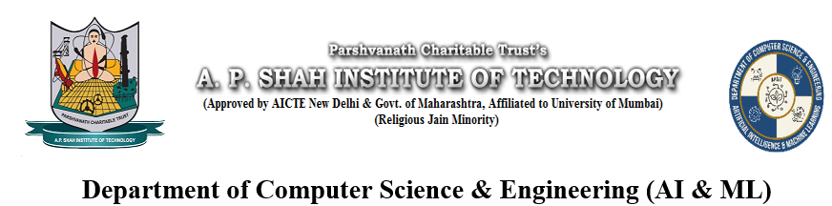
Disease Prediction Using Retinal Scan
A Mini Project by
Under the Guidance of
Prof. Poonam Tiware
2025-2026
Shitanshu Yadav | 23106081
Aachal Pandey | 23106064
Prajwal Dhanawade | 24206007
Gaurav Kshirsagar | 24206009
Notes:
1

Slide 2
Presentation Outline
Introduction
Literature Survey of the Existing Systems
Limitations of the Existing Systems
Problem Statement
System Design
Technologies and Methodologies
Implementation Screenshots(Partial )
Conclusion
References
Notes:
2

Slide 3
Introduction
Eye health is crucial for quality of life, and early detection of diseases like cataract, glaucoma, and diabetic retinopathy can prevent blindness. Traditional diagnosis often requires costly equipment and expert consultation. With advancements in AI and Deep Learning, automated image-based diagnosis has become possible. This project presents a web-based application that analyzes eye images and provides quick, accessible, and affordable diagnosis support.
Notes:
3

Slide 4
Sustainable Development Goal:
Good Health & Well-being:
Promotes health by enabling early, accessible screening to prevent blindness from retinal diseases.
Reduced Inequalities
Reduces healthcare disparities by bringing expert-level diagnostics to remote and underserved communities.
Industry, Innovation & Infrastructure
Drives medical innovation by integrating advanced AI technology into frontline healthcare systems.

Slide 5
Literature Survey On Existing System
Title | Year | Key Points | Known Limitations (Lacks) | Citation
A Deep Learning-Based Framework for Retinal Disease Classification | 2024 | Provides a comprehensive framework for classifying multiple retinal diseases using deep learning. | Generalizability to diverse, real-world clinical datasets; a detailed interpretability module. | [1]
A Foundation Model for Generalizable Disease Detection from Retinal Images | 2023 | A single, large-scale model generalizes well across multiple retinal diseases and datasets. | Fine-grained interpretability ("black box" nature); validation in prospective clinical trials. | [4]
Transfer Learning for Retinal Vascular Disease Detection: A Pilot Study | 2022 | A pilot study showing transfer learning is effective for detecting Diabetic Retinopathy and Retinopathy of Prematurity. | Large-scale validation beyond a pilot scope; performance on other retinal vascular conditions. | [2]
Development and Validation of a Deep Learning Algorithm for DR Detection | 2016 | A foundational paper that demonstrated high accuracy for detecting Diabetic Retinopathy using deep learning. | A narrow focus on a single disease (DR); comparison with more modern architectures (e.g., Transformers). | [3]
Notes:
5

Slide 6
Limitations Of Existing Systems
Inefficient Manual Diagnosis: The current reliance on manual interpretation by specialists is costly, time-consuming, and creates significant diagnostic bottlenecks in the healthcare system.
Inaccessible AI Prototypes: High-accuracy AI models developed in research often remain as complex prototypes, lacking the user-friendly interfaces needed for practical application by clinicians or educators.
Foundational Dataset Limitations: The development of robust and fair AI is consistently challenged by underlying data issues, most notably class imbalance and inconsistent image quality.
Notes:
6

Slide 7
Problem statement
Eye diseases like diabetic retinopathy, glaucoma, and cataract are major causes of vision loss worldwide. Traditional diagnosis is costly and inaccessible for many, especially in rural areas. A web-based AI system can enable quick, affordable, and accessible preliminary screening, improving early detection and preventing avoidable blindness.

Slide 8
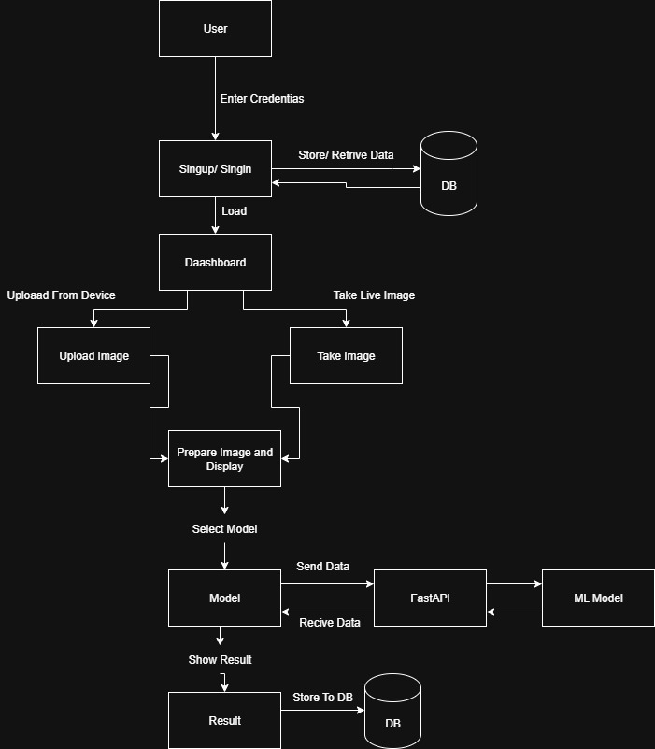
Overview of System Design
Notes:
8

Slide 9
Technology and Methodologies
                Platform:
                Kaggle Notebooks + NVIDIA T4 x2 GPU
                Languages:
                Python
                Libraries:
                TensorFlow/Keras , Numpy ,Pandas , Matplotlib, Seaborns,
                Models:
                EfficientNetB4
                MobilNetV3_Large
                Dataset:
                A dataset of color fundus images for the detection and classification of eye diseases
                >
Notes:
9

Slide 10
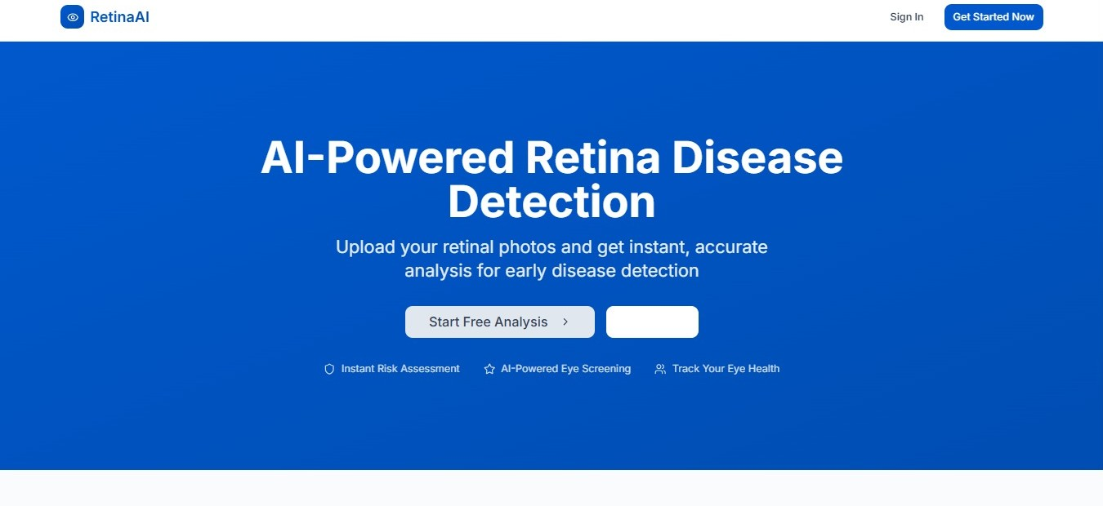
Implementation

Slide 11
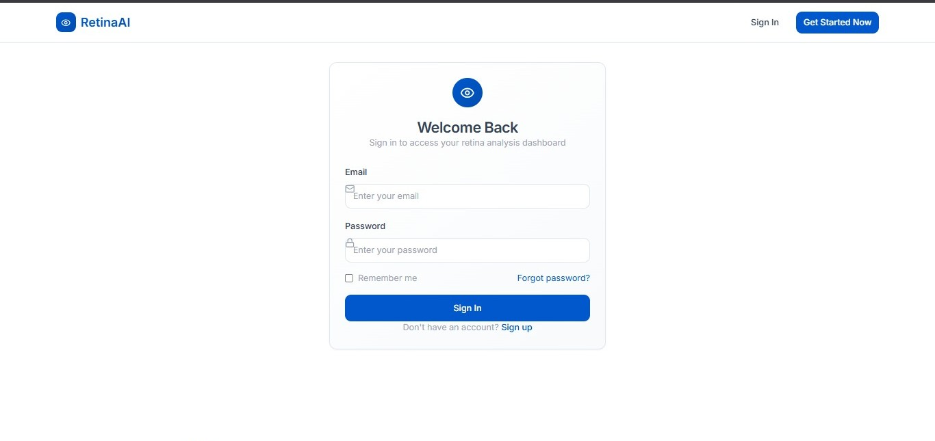
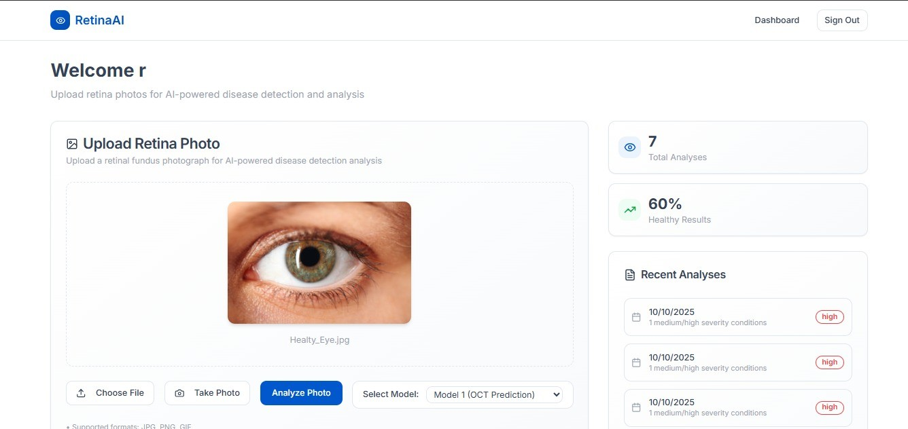

Slide 12
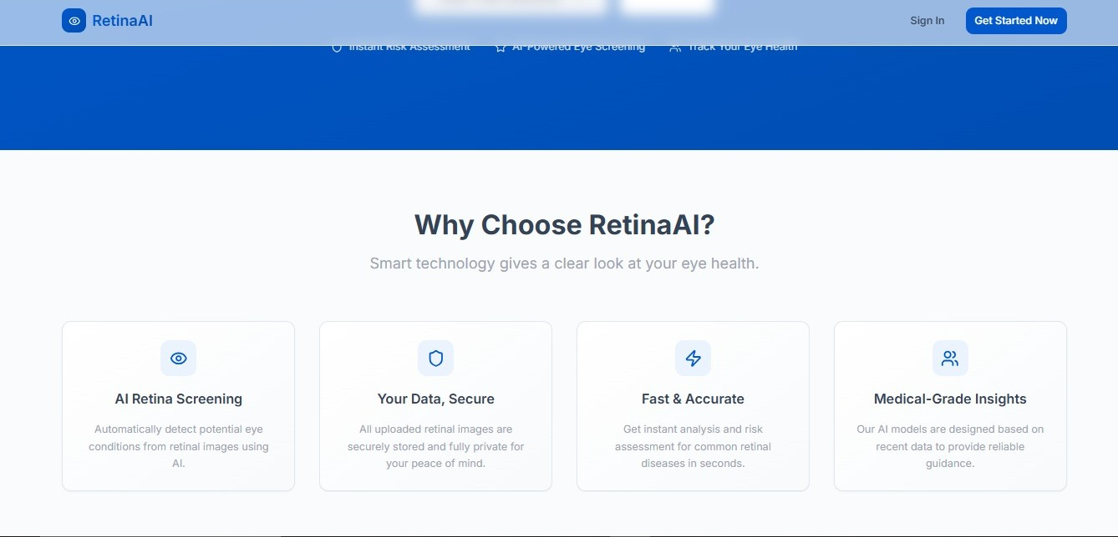
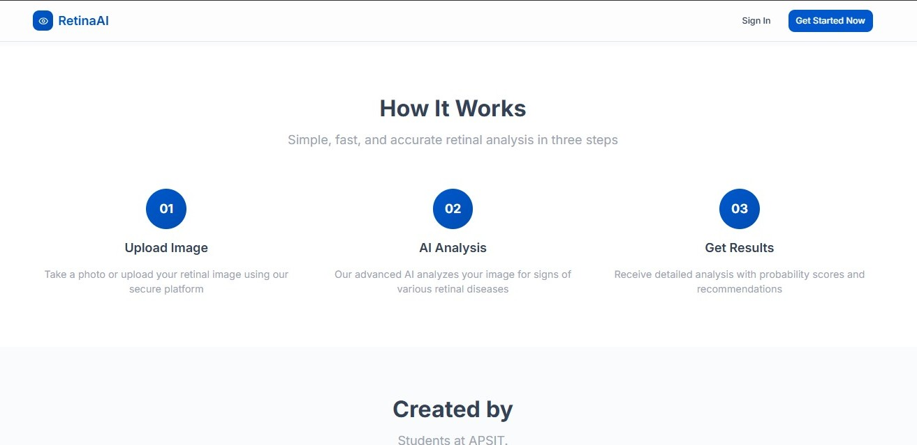

Slide 13
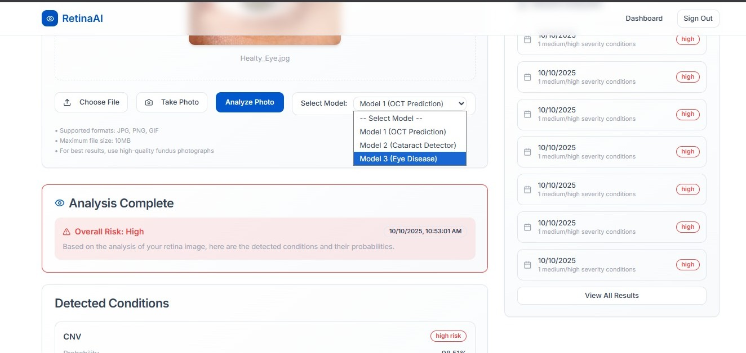
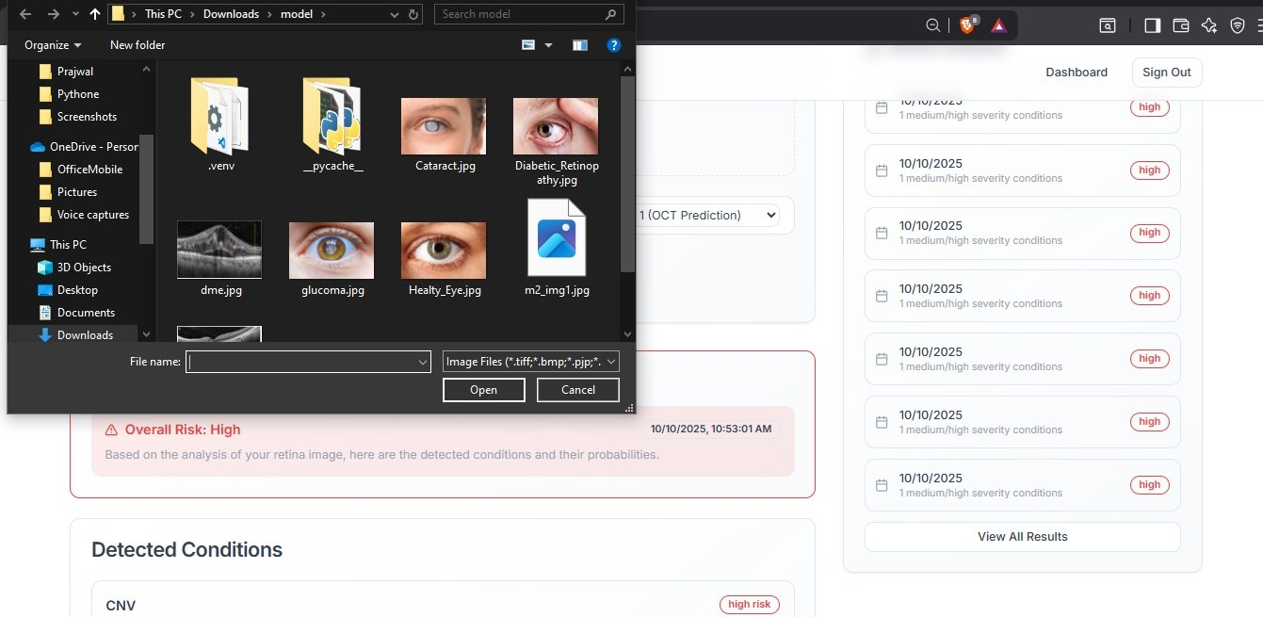

Slide 14
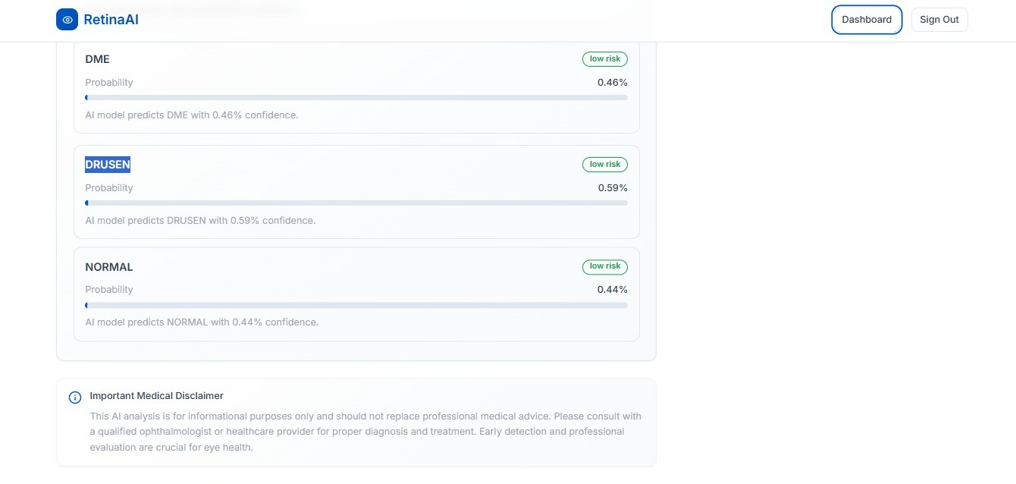

Slide 15
Future Scope
Integrate Multimodal Data: Fuse retinal image analysis with clinical EHR data (e.g., HbA1c levels) for a more holistic diagnosis.
Advance Explainable AI (XAI):Move beyond heatmaps to provide interactive, query-based explanations for clinical trust and validation.
Develop API for Integration: Build a secure RESTful API for seamless integration of the AI tool into existing hospital EHR and PACS workflows.
Implement Federated Learning: Train on decentralized data from multiple institutions to improve model generalization and mitigate algorithmic bias.
Notes:
15

Slide 16
Conclusion
This project uses Artificial Intelligence and Deep Learning to provide quick, accurate, and accessible eye disease detection through a web-based application. By automating the screening process with real-time predictions and a simple interface, it promotes early diagnosis, increases awareness, and helps prevent avoidable vision loss.
Notes:
16

Slide 17
References
REFERENCES
[1] P. A. Kumar, R. R. Sreeja, and S. A. Vishnu, “A Deep Learning-Based Framework for Retinal Disease Classification,” Sensors, vol. 24, no. 5, Art. 2252574, 2024. [Online]. Available: https://www.mdpi.com/2252574
[2] S. Patel and V. Rao, “Transfer Learning for Retinal Vascular Disease Detection: A Pilot Study with Diabetic Retinopathy and Retinopathy of Prematurity,” arXiv preprint arXiv:2201.01250, 2022. [Online]. Available: https://arxiv.org/abs/2201.01250
[3] V. Gulshan et al., “Development and Validation of a Deep Learning Algorithm for Detection of Diabetic Retinopathy in Retinal Fundus Photographs,” JAMA, vol. 316, no. 22, pp. 2402–2410, 2016, doi: 10.1001/jama.2016.17216.
[4] K. Zhou, Z. Ruan, et al., “A Foundation Model for Generalizable Disease Detection from Retinal Images,” Nature, vol. 622, no. 7982, pp. 156–163, 2023, doi: 10.1038/s41586-023-06555-x.
Notes:
17

Slide 18
THANK YOU
Notes:
18

